Slide 1

U.S. Movies Citation Network
Ameer Khan Shawn Li Ye (Iris) Tu

Slide 2

Overview
Introduction
Network Statistics
Hypotheses
Ergm Models
Model Analysis

Slide 3



Introduction

Slide 4
Movie Citation Network
3185 Movies
4634 References
Time Span: 2009 – 2011
Additional data from OMDB API, including imdb ratings, tomato meter, production house, genre and etc.

Slide 5


Network Statistics

Slide 6
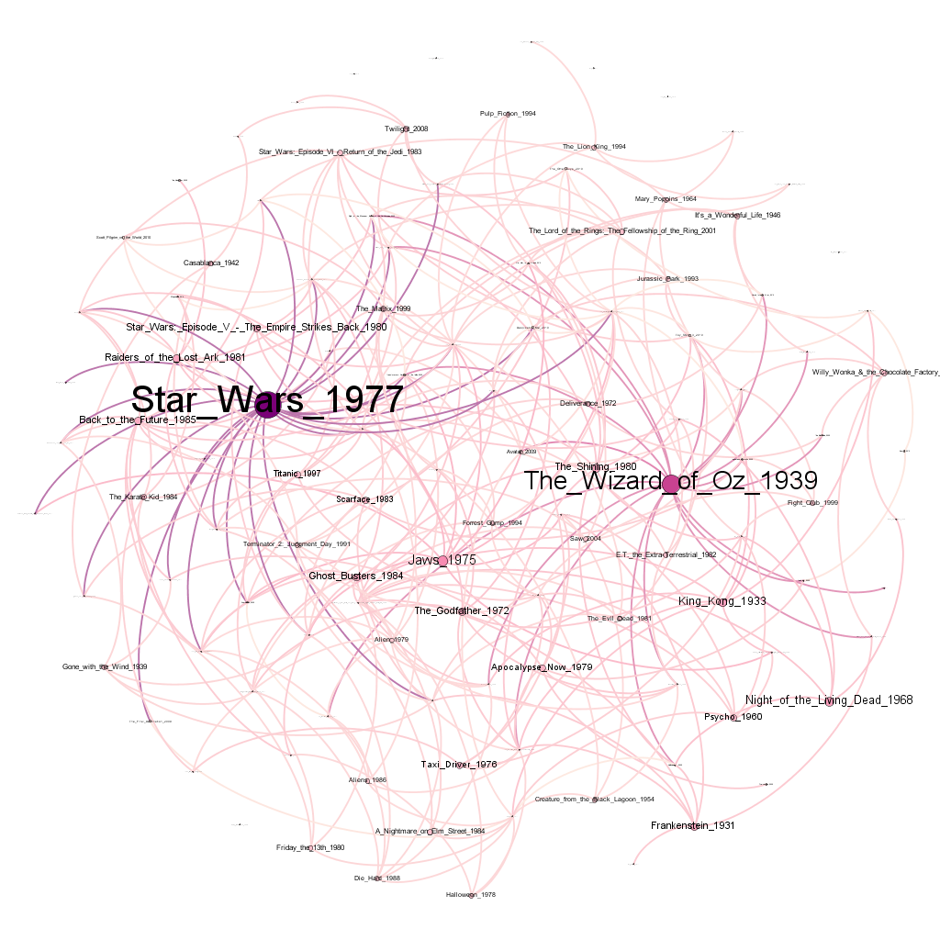
In-Degree Centrality
Movies | In-Degree
Star Wars 1977 | 88
The Wizard of Oz 1939 | 60
Jaws 1975 | 32
Night of the Living Dead 1968 | 26
King Kong 1933 | 25
The Shining 1980 | 23
Raiders of the Lost Ark 1981 | 23
Frankenstein 1931 | 22
The Godfather 1972 | 22
Star Wars: Episode V - The Empire Strikes Back 1980 | 21

Slide 7
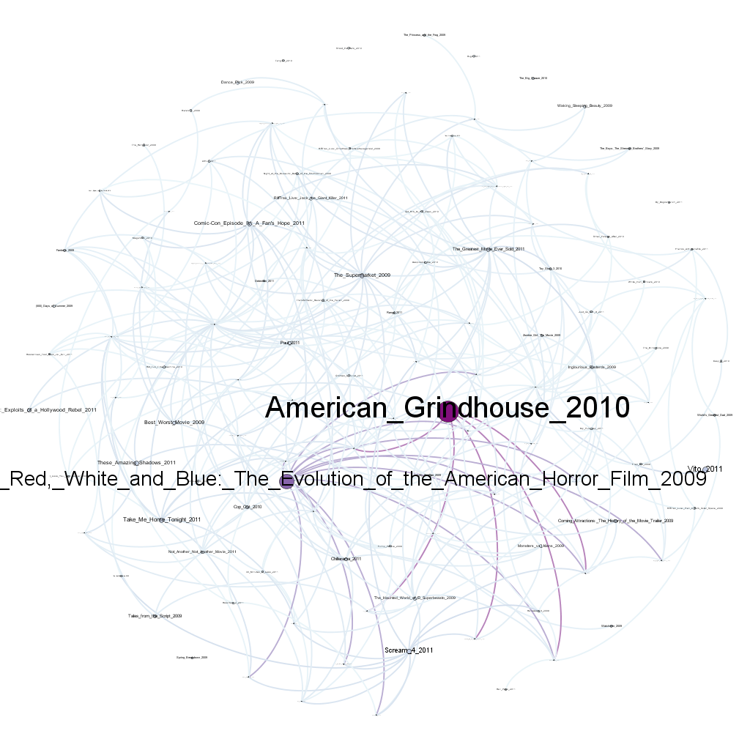
Out-Degree Centrality
Movies | Out-Degree
American Grindhouse 2010 | 305
Nightmares in Red, White and Blue 2009 | 207
Vito 2011 | 75
Scream 4 2011 | 62
Take Me Home Tonight 2011 | 55
These Amazing Shadows 2011 | 51
Comic-Con Episode IV: A Fan's Hope 2011 | 48
The Supermarket 2009 | 47
Corman's World: Exploits of a Hollywood Rebel 2011 | 41
Best Worst Movie 2009 | 41

Slide 8
Eigenvector Centrality
Movies | Eigenvector Centrality
Star Wars 1977 | 1.000000000
The Wizard of Oz 1939 | 0.761937155
Jaws 1975 | 0.345318645
The Shining 1980 | 0.300250218
King Kong 1933 | 0.287003499
Raiders of the Lost Ark 1981 | 0.260112046
The Godfather 1972 | 0.251133561
Star Wars: Episode V | 0.25108956
Night of the Living Dead 1968 | 0.22375082
Ghost Busters 1984 | 0.215351626

Slide 9
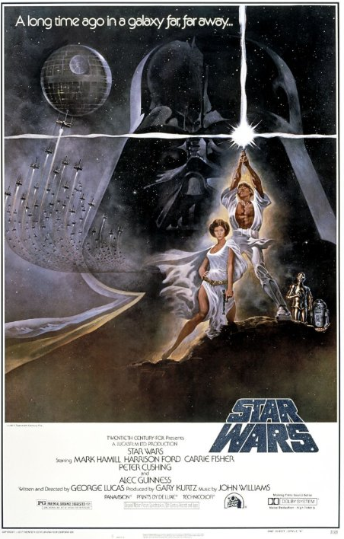


Slide 10
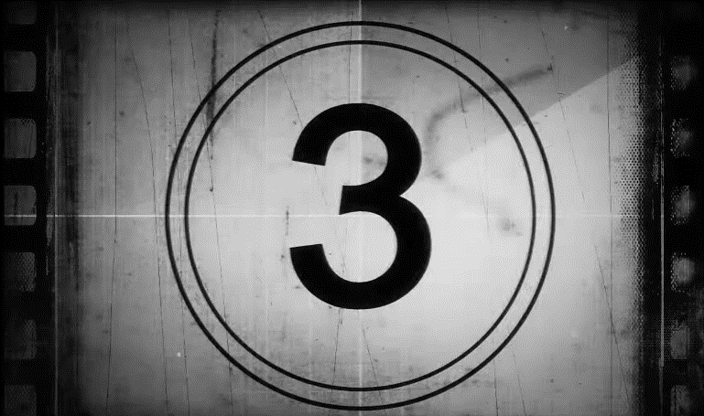
Hypotheses

Slide 11
Hypotheses
Are highly-rated movies more likely to be cited?
Do popular movies get more citations?
Are movies from top production houses referenced more frequently?
Are movies tend to cite others from the same production house?
Are movies likely to cite others from the same genre?
Do critically acclaimed movies get cited more?

Slide 12
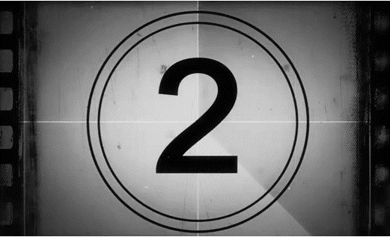
ERGM Model

Slide 13
ERGM Model: Effects of Ratings and Popularity
Effects | Estimate | Significance | Interpretation
edges | -8.525 | *** | Movie references are not likely to be random
transitive | 1.337 | *** | Movies tend to cite movies referened by their citations
IMDB Rating of Cited Movie | 0.0524 | *** | Highly rated movies tend to be cited more
IMDB Votes of Cited Movie | 0.000002 | *** | Popular movies tend to be cited more
Tomatometer of Cited Movie | 0.0111 | *** | Critical acclaim increases the likelihood for a movie to be cited

Slide 14
ERGM Model: Effects of Production House
Effects | Estimate | Significance | Interpretation
References within same Production House | 0.6289 | *** | Movies are more likely to reference others from the same production house
Citations for 20th Century Fox Movies | 0.2949 | *** | 20th Centry Fox movies are more likely to be cited
Citations for Paramount Pictures Movies | 0.3051 | *** | Paramount Pictures movies are more likely to be cited
Citations for Universal Pictures Movies | 0.2951 | *** | Universal Pictures movies are more likely to be cited
Citations for Warner Bros. Pictures Movies | 0.2577 | *** | Warner Bros. Pictures movies are more likely to be cited

Slide 15
ERGM Model: Effects of Movie Genres
Effects | Estimate | Significance | Interpretation
References within Comedy Genre | -0.2309 | *** | Comedy movies are less likely to cite other comedies
References within Crime Genre | 0.5167 | *** | Crime movies tend to reference movies from the same genre
References within Romance Genre | 0.2455 | *** | Romance movies tend to reference movies from the same genre
References within Sci-Fi Genre | 0.1299 | ** | Sci-fi movies tend to reference movies from the same genre
References within Documentaries | -1.2210 | *** | Documentaries are not likely to reference other documentaries

Slide 16


Model Diagnostics

Slide 17
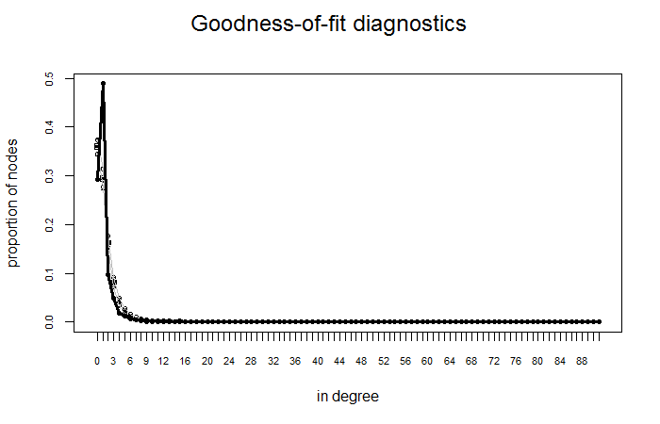
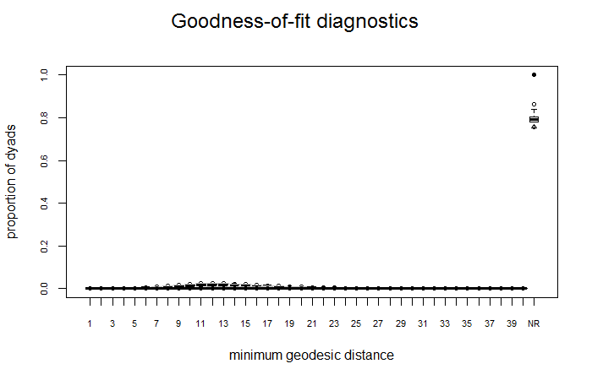
Goodness of Fit

Slide 18
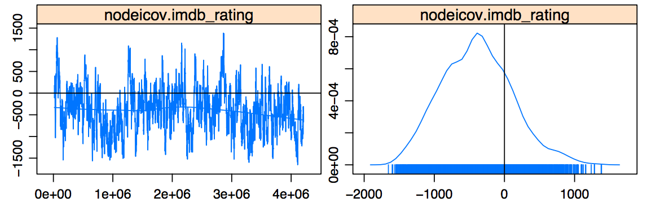
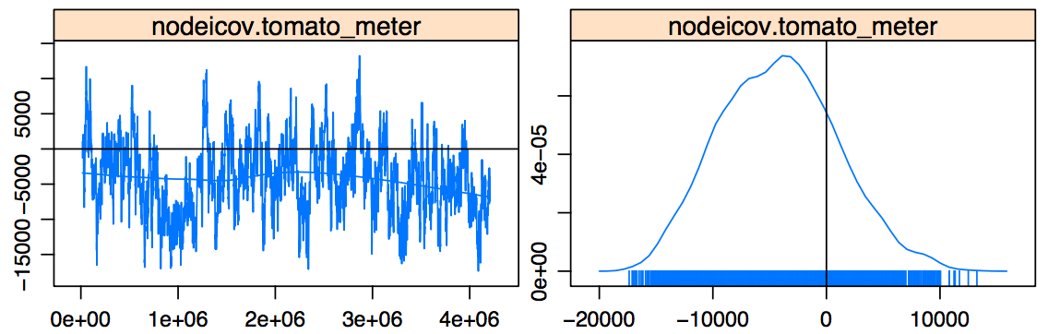
MCMC Diagnostics

Slide 19
Thank you!

Slide 20
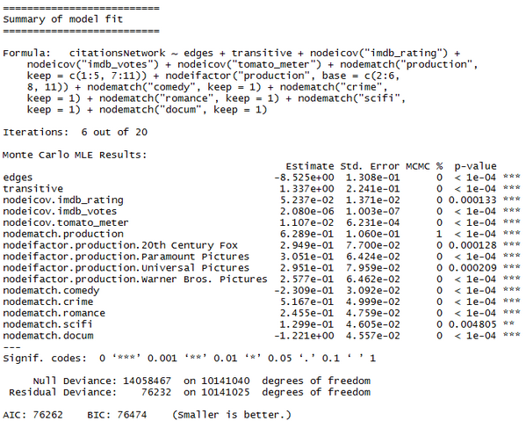
Appendix

